Slide 1
Slow Dance Your Way to Success
How does a batter’s walk on music affect pitcher performance?

Slide 2
Our Plan
Inspiration
Research in other sports suggests matching music BPM with activity tempo improves performance
No such research has been completed in baseball
Our approach
Compiled a data set of Orioles players’ walk on songs including song name, title, and beats per minute
Matched Pitch f/x data to song information
Correlated pitch speed and BPM of the walk on song
Subsetted data to look only at the 1st pitch and only fastballs and only when batters were home
Final regression examining relationship batter getting a hit and BPM

Slide 3
Hypothesis
“Music alters emotional and physiological arousal and can therefore be used prior to competition or training as a stimulant, or as a sedative to calm "up" or anxious feelings (Bishop et al., 2007). Music thus provides arousal regulation fostering an optimal mindset.”
http://thesportjournal.org/article/music-sport-and-exercise-update-research-and-application/
Hypothesis: Lower BPM will enhance batter’s performance (hit) while higher BPM will enhance pitcher performance (pitch speed).

Slide 4
Our Findings
Range of BPM in songs studied: 73-174
For every additional 100 BPM a batter is 8% less likely to hit the ball into play on the first pitch

Slide 5
Our Findings

Slide 6
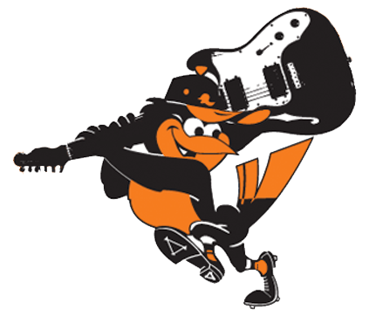
Thank You

